Slide 1
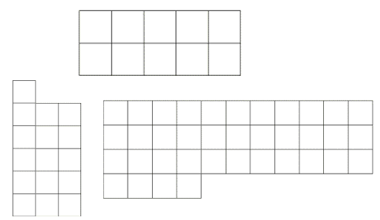
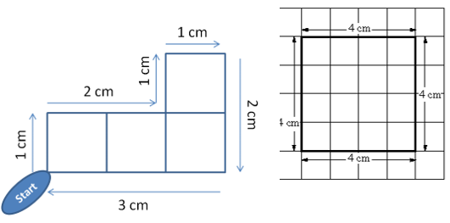

Subtopic N3.6 – Area of Rectangles, Parallelograms, Triangles and Compound Shapes
LEARNING OUTCOME: To understand how to find the area of different shapes.
Keywords:
Area
Shape
Height
Base
Perpendicular
Objectives:
To find the area of rectangles, parallelograms and triangles
To apply those skills to be able to solve problems involving compound shapes
Introduction – read and annotate:
Area is the amount of space a shape covers, and we measure it in square units like cm² or m². Finding
the area of squares and rectangles is an application of all the multiplying you've been practicing
because we work it out by multiplying the length by the width. Sometimes, you’ll be asked to find the
area of a shaded part, which might involve working out just a section of the shape. Being confident
with multiplication helps you solve these problems accurately.
Definition
Characteristics
The measure of space in two dimensions contained within a boundary (perimeter).
The inside of a 2-D shape
Usually measured using squares of length one unit (where a unit can be cm, metre, inch etc.)
Examples
Area
Non - Examples
Steps | Work out the area | Work out the area | Work out the area
1) Make sure the units are the same 2) Multiply the length by the width 3) Include the units in your answer
Area of a rectangle = length x width
Calculating the area of rectangles and squares
Example 1 - I do…
Example 2 – We do…
Example 3 – You do…
6cm
3cm
8cm
8cm
45cm²
12cm
12cm
48cm²
3cm
6cm
36cm²
12cm
5cm
12cm
12cm
5cm
12cm
7cm
25cm²
144cm²
49cm²

Slide 2

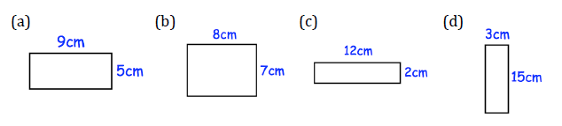
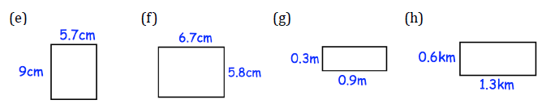
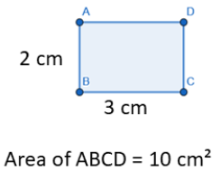
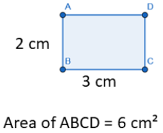
Example 4 - I do…
Example 5 – We do…
Example 6 – You do…
Steps | Work out the area | Work out the area | Work out the area
1) Make sure the units are the same 2) Multiply the length by the width 3) Include the units in your answer
7.1cm
4.9cm
5.2cm
5.2cm
4.8cm
7.1cm
24.8cm²
36.92cm²
23.52cm²
Independent Practice
1. Calculate the area of each shape. Remember to include units.
a) | b) | c) | d)
e) | f) | g) | h)
45cm²
56cm²
24cm²
45cm²
51.3cm²
38.86cm²
0.27m²
0.78km²
2. The shapes below are rectangles. True or false?
a) |  | b)
 | True / False |  | True / False

Slide 3
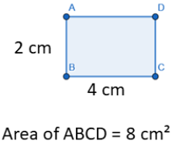
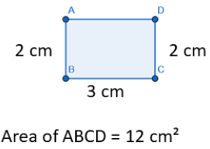
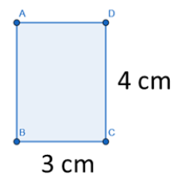
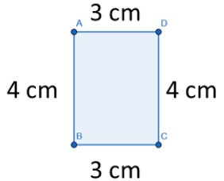


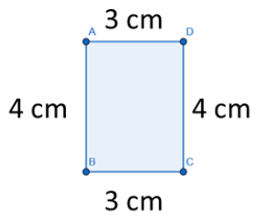
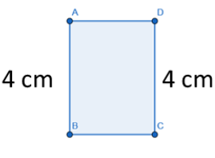


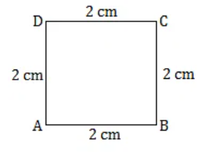
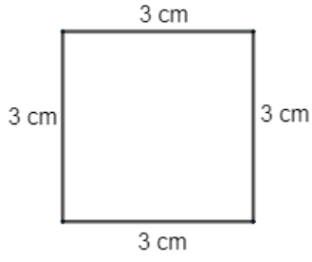
c) |  | d)
 | True / False |  | True / False
e) |  | f)
 | True / False |  | True / False
g) |  | h)
 | True / False |  | True / False
3. Calculate the areas of the following squares.
a) | b)
4cm²
9cm²

Slide 4
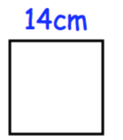
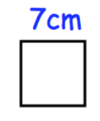
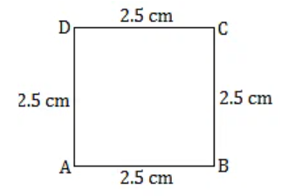
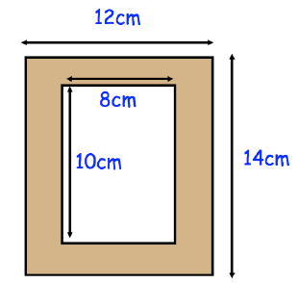
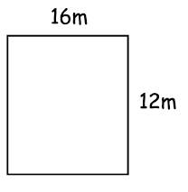
c) | d)
e) | f)
196cm²
49cm²
8.5mm
6.25cm²
72.25mm²
4. Shown below is a wooden picture frame. Work out the shaded area.
88cm²
5. The perimeter of a square is 28cm. Find the area of the square.
49cm²
6. Jess wants to lay some grass on her lawn (diagram below). Each square metre costs £23. How much will the grass cost?
£4416

Slide 5
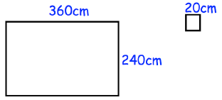
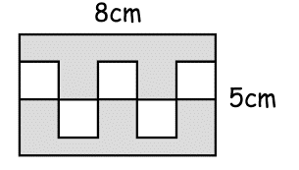
7. Mr Jenkins has a grass lawn that is 24m wide and 30m long. He cuts the grass at a rate of 9m² per minute. How long will it take Mr Jenkins to cut all the grass?
80 minutes
8. A rectangular room is 14m long and 8m wide. Jessica is going carpet the room with carpet that costs £17.50 per square metre. She has saved up £2000. Does she have enough money to pay for the carpet? You must show your working.
Yes as it would cost £1960
9. Mrs Rodgers is tiling her bathroom wall. The bathroom wall is 360cm long and 240cm high. Each tile is 20cm by 20cm. The tiles are sold in boxes of 6. Each box costs £8. How much will it cost Mrs Rodgers to tile her bathroom wall?
£288
10. Rory made a rectangular logo, 8cm long and 10cm wide. There are 5 identical white squares and the rest of the logo is shaded. Find the area that is shaded.
10cm
30cm²
11. A football pitch is 110m long and has a perimeter of 360m. Find the area of the football pitch.
7700m²

Slide 6
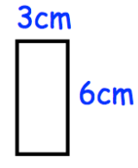
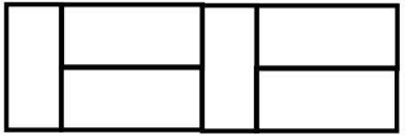
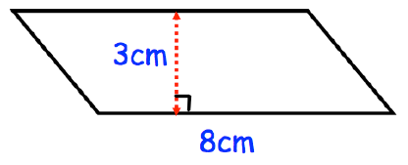
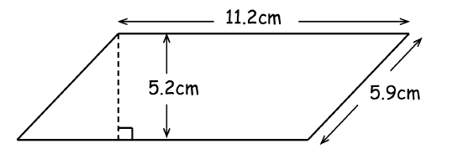
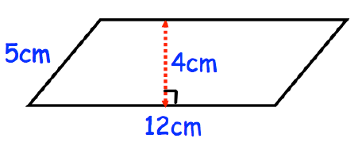
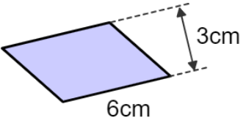
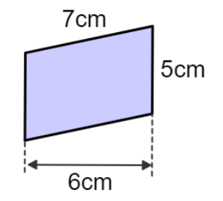
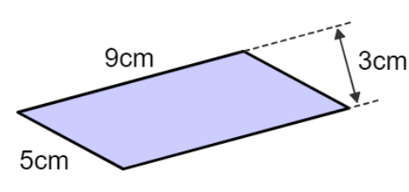
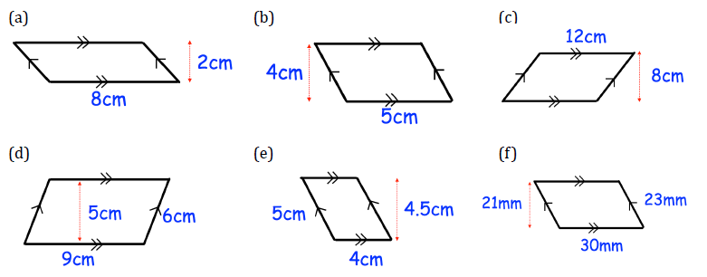
12a) A rectangle is 3cm by 6cm. Six of the rectangles are used to make a larger rectangle. Work out the area of the larger rectangle.
12b) Calculate the perimeter of the larger rectangle.
108cm²
48cm
Area of a parallelogram
Area of a parallelogram = base x perpendicular height
Example 7 - I do…
Example 8 – We do…
Example 9 – You do…
Steps | Work out the area | Work out the area | Work out the area
1) Make sure all your units are the same 2) Multiply the base by the perpendicular height 3) Remember to add the units to your answer
24cm²
58.24cm²
48cm²
18cm²
30cm²
27cm²
Independent Practice
13. Find the area:
a) | b) | c) | d)
16cm²
20cm²
96cm²
45cm²

Slide 7
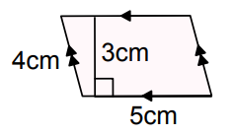
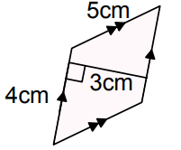
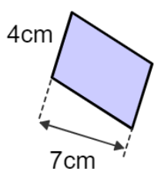
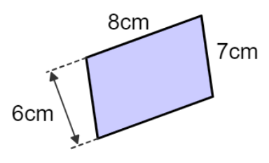
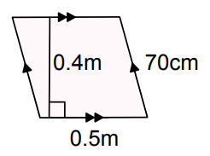
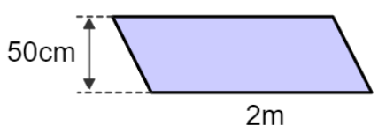
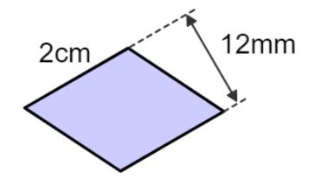
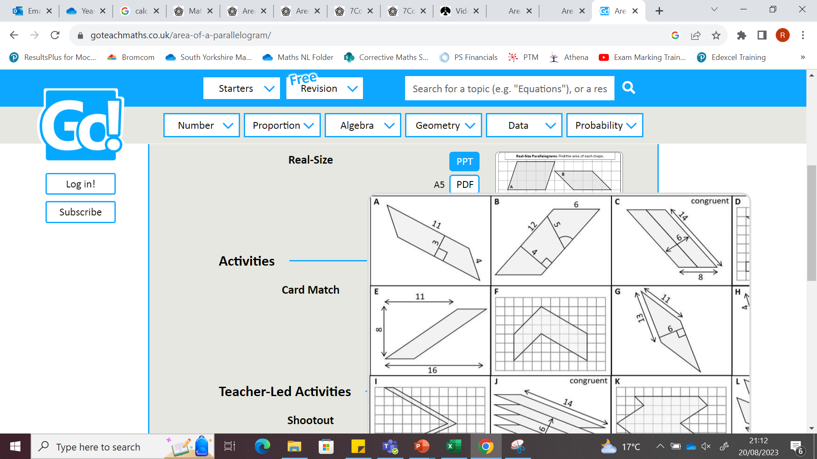
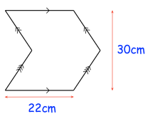
e) | f) | g) | h)
630mm²
18cm²
15cm²
12cm²
i) | j) | k) | l)
m) | n) | o) | p)
28cm²
48cm²
0.2m²
1m²
cm
cm
cm
cm
cm
cm
cm
cm
cm
cm
2.4cm²
40cm²
78cm²
48cm²
14. The logo below is created by joining two congruent parallelograms. Calculate the area of the logo.
660cm²
‹#›

Slide 8
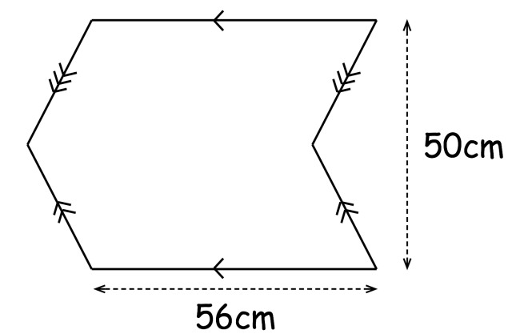
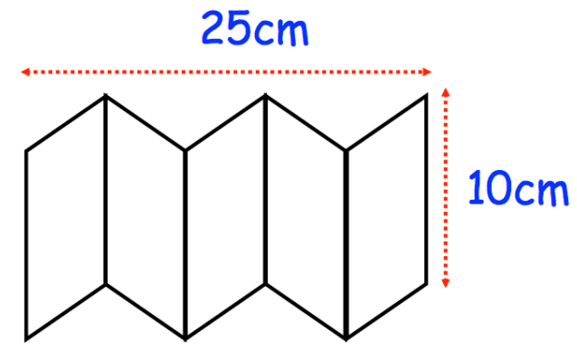
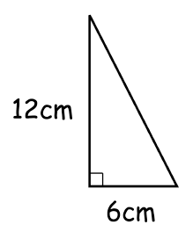
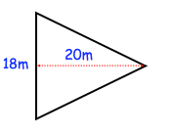
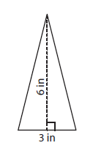
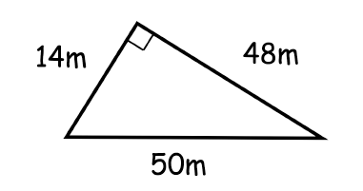
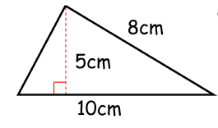
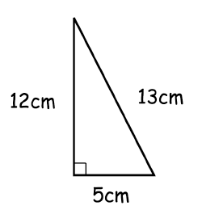
15. The logo below is created by joining two congruent parallelograms. Calculate the area of the logo.
2800cm²
16. The diagram shows a logo that is made up of 5 identical parallelograms. Find the area of one parallelogram.
250cm²
Steps | Work out the area | Work out the area | Work out the area
1) Make sure all your units are the same. 2) Multiply the base by the perpendicular height. 3) Remember to add the units to your answer
Area of a triangle
Area of a triangle = (base x perpendicular height) ÷ 2
Example 10 - I do…
Example 11 – We do…
Example 12 – You do…
36cm²
180m²
9in²
Example 13 - I do…
Example 14 – We do…
Example 15 – You do…
Steps | Work out the area | Work out the area | Work out the area
1) Make sure all your units are the same. 2) Multiply the base by the perpendicular height. 3) Remember to add the units to your answer
336m²
25cm²
30cm²
‹#›

Slide 9
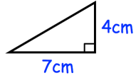
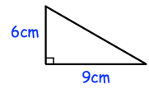
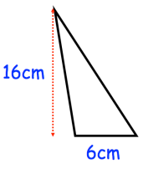







Independent Practice
17. Calculate the area:
a) | b) | c) | d)
14cm²
27cm²
48cm²
24m²
e) | f) | g) | h)
i) | j) | k) | l)
 | Find the area of a triangle with a base of 12cm and a perpendicular height of 9cm | Find the area of a triangle with base 9cm and perpendicular height 14cm | Find the area of a triangle with base 19cm and height of 7cm
m) | n) | o) | p)
27cm²
500cm²
28cm²
31.5m²
27.5cm²
54cm²
63cm²
66.5m²
5.1m
9m
8.3km
20.14km²
19.44cm²
21.58m²
22.05m²
‹#›

Slide 10




18. This shape is made from three congruent right-angled triangles. Find the total area of the shape.
48cm²
19. Shown below is a logo made from a square and two triangles. Calculate the area of the logo.
120cm²
20. Shown below is a triangular field. Each chicken requires 3m². How many chickens can be kept in this field?
10
30
21. Shown is a square garden with a triangular pond. Find the area of the garden that is grass.
24m²

Slide 11




22. Shown is a triangular brick wall with a rectangular window. Find the area of the wall that is brick.
18m²
Steps | Find the area | Find the area | Find the area
1) Split the shape into rectangles/ squares 2) Work out the area of each shape 3) Add the areas together
Area of compound shapes (squares and rectangles only)
Example 16 - I do…
Example 17 – We do…
Example 18 – You do…
7cm
5cm
4cm
2cm
1cm
5cm
3cm
8cm
3cm
10cm
2cm
4cm
6cm
3cm
44cm²
30cm²
10cm²
Independent Practice
23. Calculate the area:
a) | b) | c) | d)
36cm²
26cm²
78cm²
186cm²

Slide 12












e) | f) | g) | h)
i) | j) | k) | l)
m) | n) | o) | p)
 | Work out the shaded area: | Work out the shaded area: | Work out the shaded area:
65m²
107cm²
72cm²
360cm²
92cm²
47cm²
31cm²
360cm²
168cm²
33cm²
70cm²
195cm²

Slide 13







Area of compound shapes (mixture of all previous shapes)
Example 19 - I do…
Example 20 – We do…
Example 21 – You do…
Steps | Find the area | Find the area | Find the area
1) Split the shape into shapes you can work out the area of 2)Work out the area of each shape 3) Add the areas together
470m²
4.5m²
273m²
Independent Practice
24. Find the area of each shape.
a) | b) | c) | d)
e) | f) | g) | h)
33cm²
100cm²
45.5cm²
690m²
40cm²
53cm²
50cm²
30cm²

Slide 14





25. William is painting the side of his house. He has 8 litres of paint and each litre of paint covers 16m². Does William have enough paint?
128cm²
26. The diagram represents the side view of a shed with a sloping roof. Calculate the area of the side view of the shed.
4.5m²
27. Farmer Martin keeps chickens in the field below. Each chicken needs 3m². What is the maximum number of chickens that he can keep?
95
4000
28. The diagram shows the plan of a field. The farmer sells the field for £3 per square metre. Work out the total amount of money the farmer should get.
£31425
‹#›

Slide 15










Skills Check
Calculate the area of the rectangle: | Calculate the area of the parallelogram:
Calculate the area of a parallelogram with a base of 1.2m and a height of 45cm. | Calculate the area of the triangle:
Calculate the area of the compound shape: | Calculate the area of the compound shape:
5.4
5.4
5400
5.4
48
3612

